Slide 1

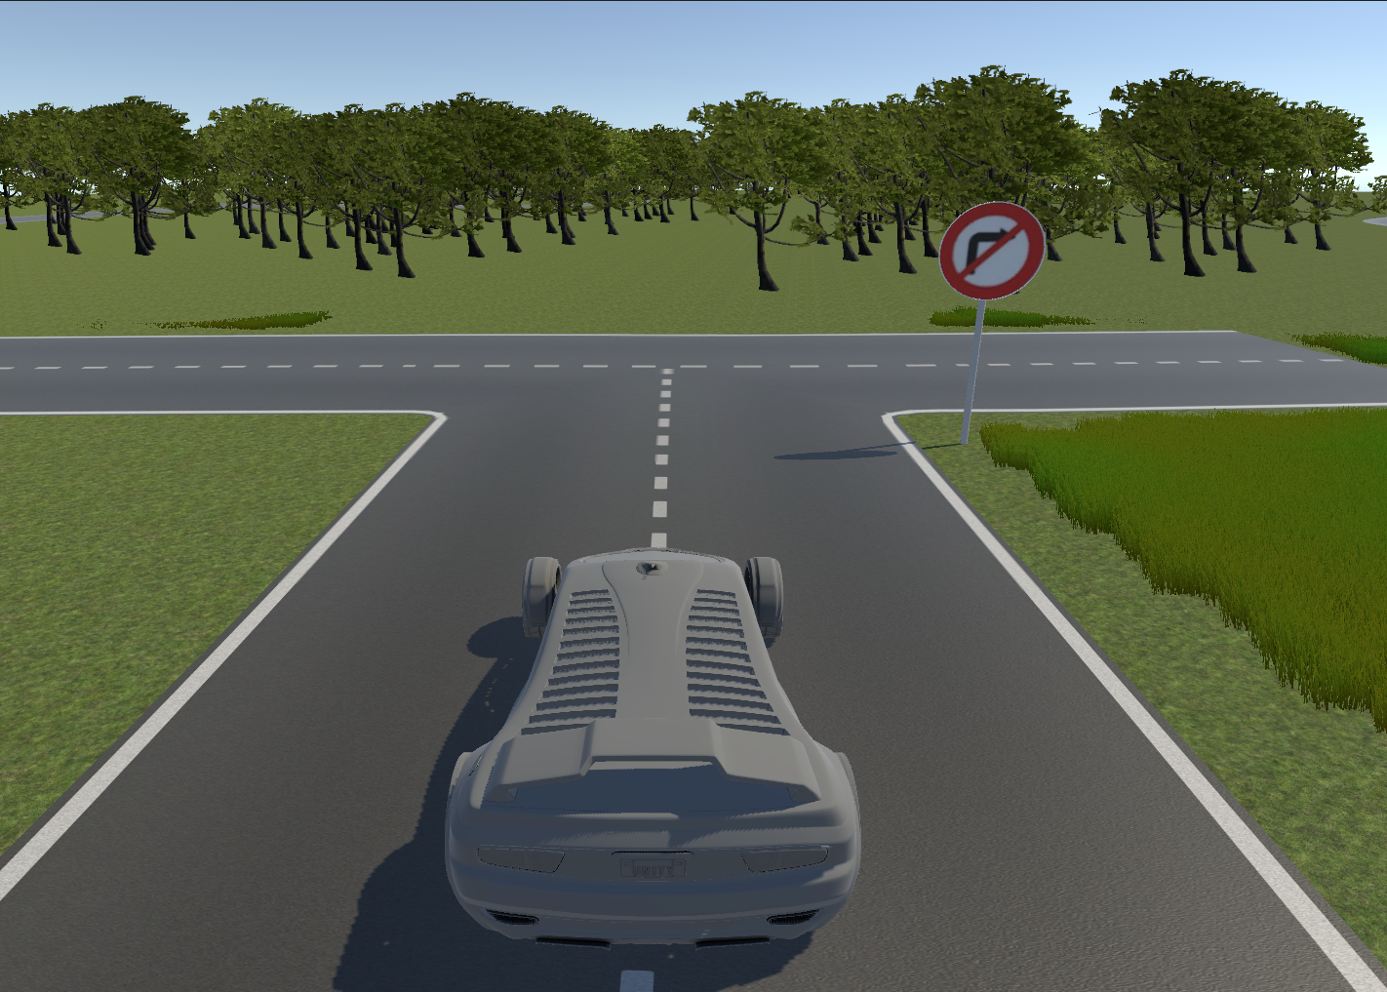

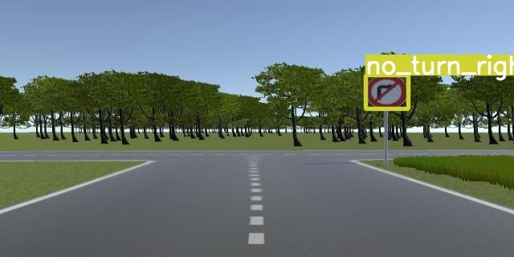
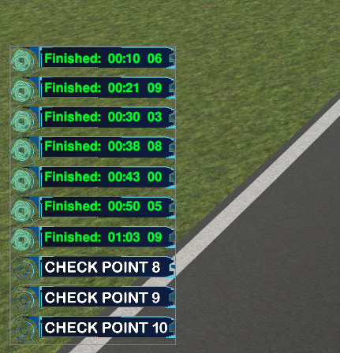
Pipeline
SPK_SANDBOX
TEAM
Lane Segmentation
Traffic Sign Detection
Controller

Slide 2
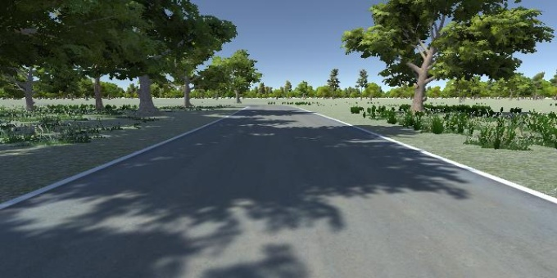
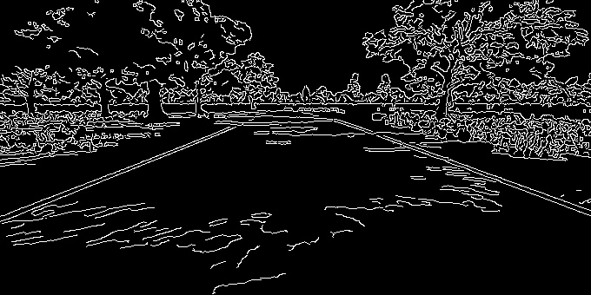
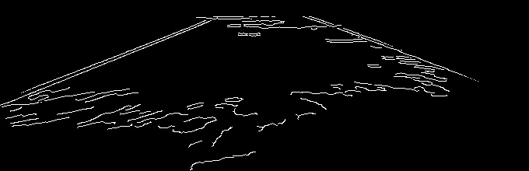
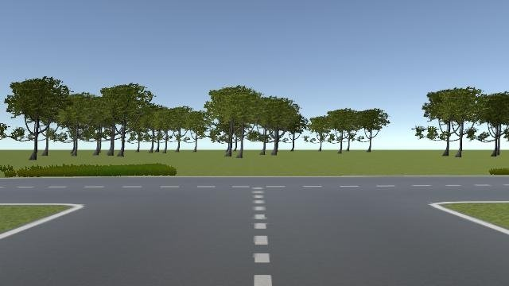
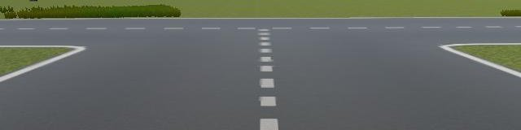
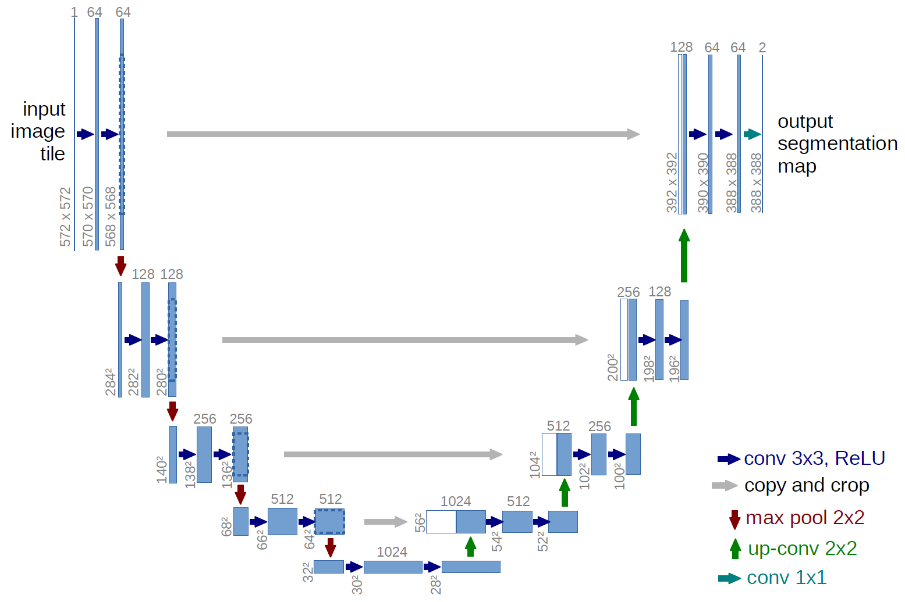

Lane Segmentation
Ảnh trả về từ phần mềm mô phỏng
Edge Detection
(Canny, Sobel,…)
ROI Image
Dataset:
Total: ⁓ 8k images Train: ⁓ 5,6k images
Val: ⁓ 1,6k images Test: ⁓ 0,8k images
Input (RGB Image)
Image Processing
UNET (Model for segmentation)
Output (Binary Image)

Slide 3
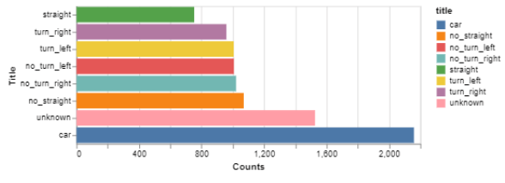
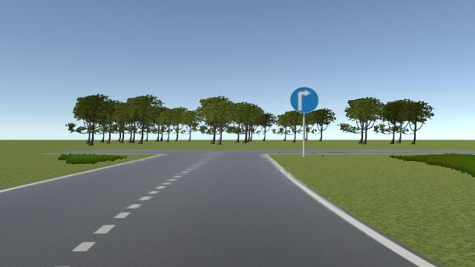
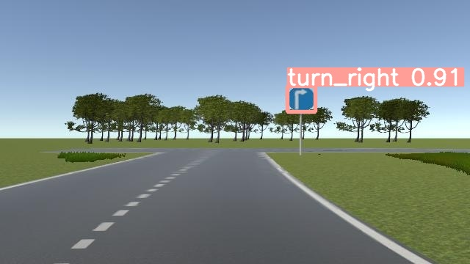
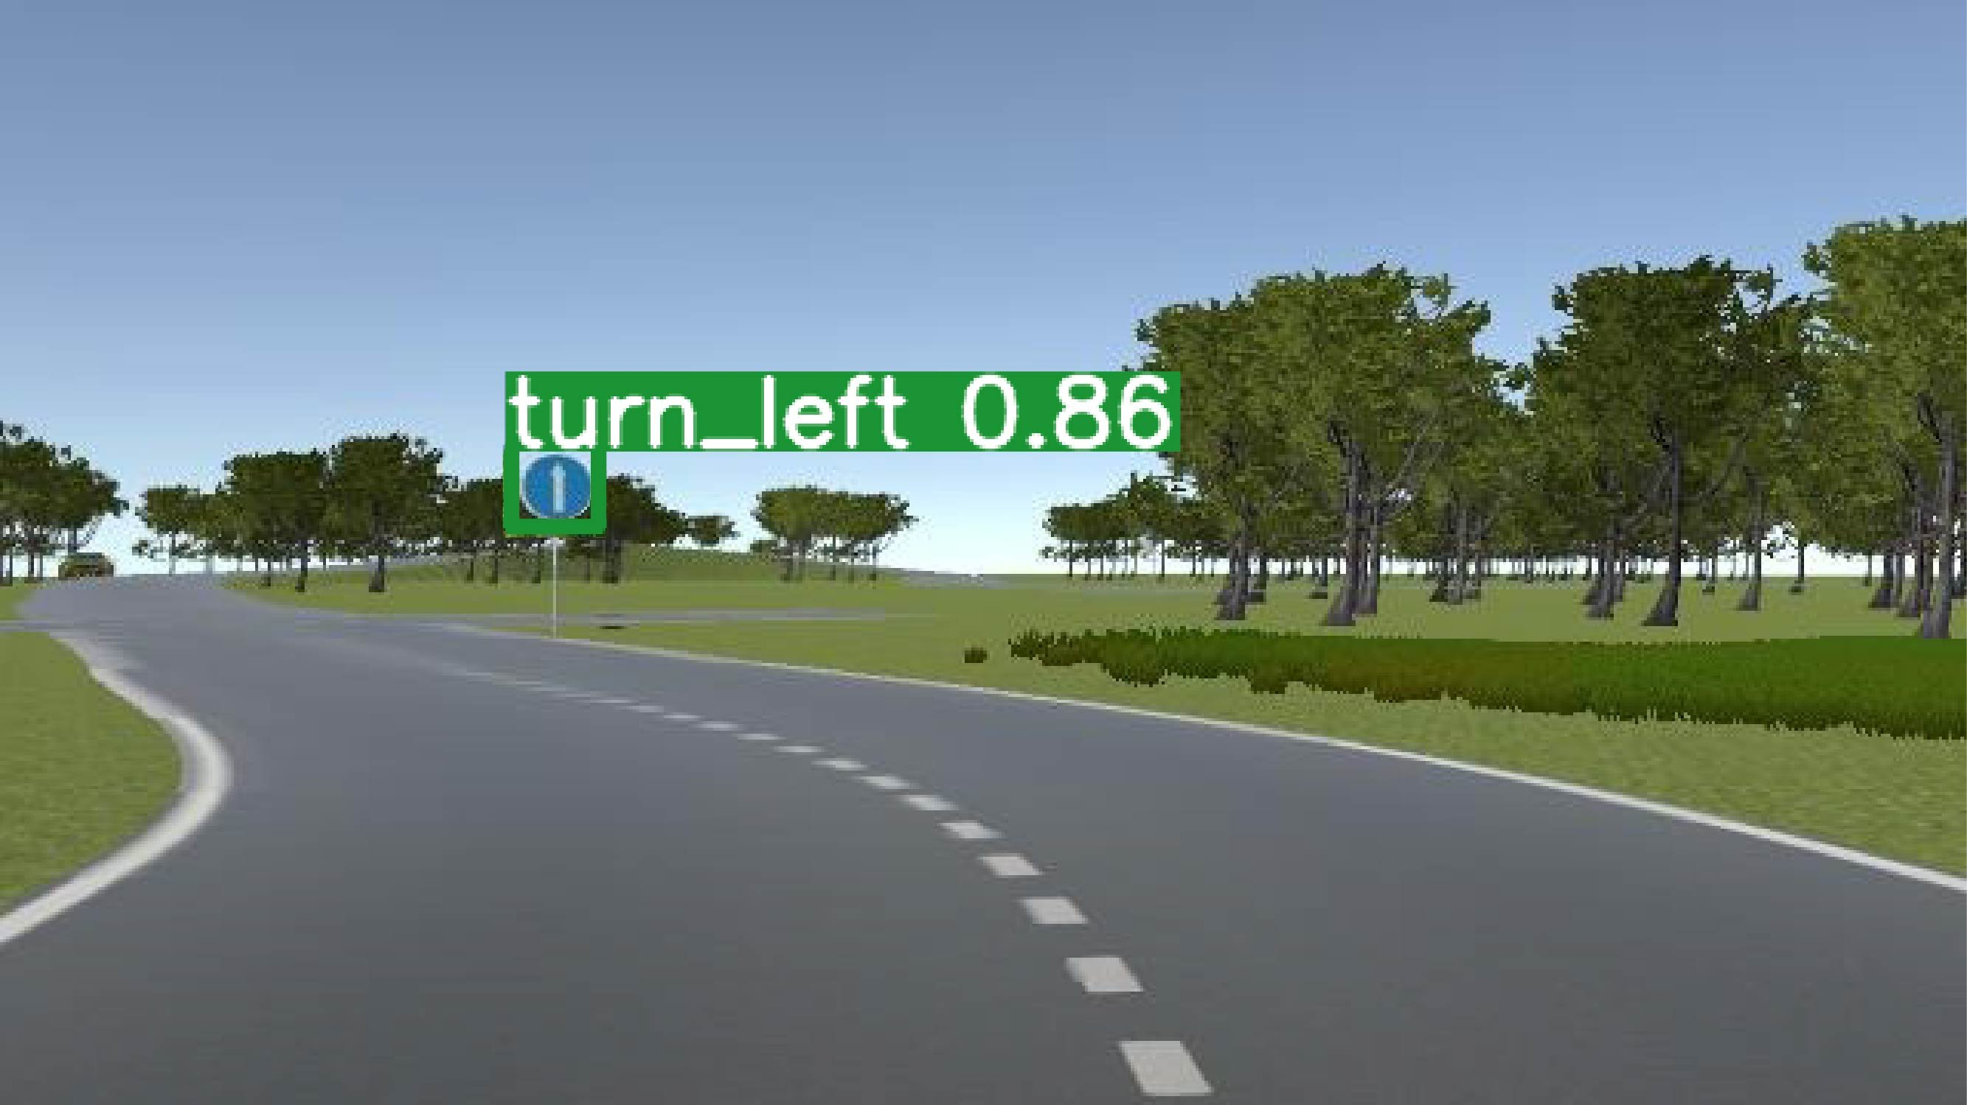
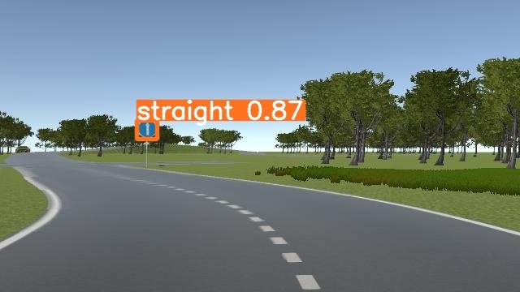
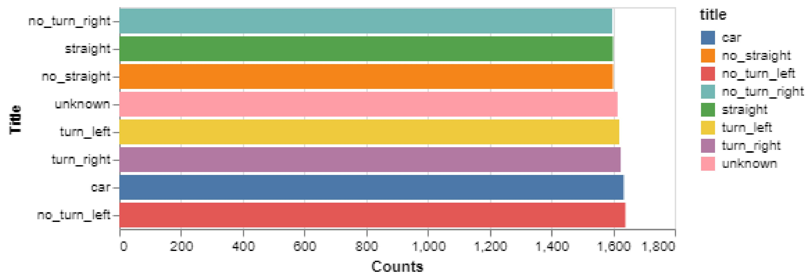
Traffic Sign Detection
Dataset: ⁓ 7k images
Model | Size | Precision | Recall | mAP@0.5 | mAP@0.5:0.95
YOLOv5m | 640 | 0.995 | 0.997 | 0.993 | 0.861
YOLOv6n | 640 | 0.994 | 0.99 | 0.996 | 0.856
YOLOv7 | 640 | 0.992 | 0.993 | 0.991 | 0.835
YOLOv8n | 640 | 0.994 | 0.998 | 0.992 | 0.887
Input
Yolov8n
Output
6 classes
Problem
Dataset: ⁓ 9k images

Slide 4
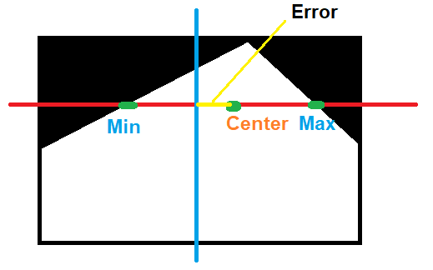
Controller
Current_Speed
Error
PID Controller
Sendback_Angle
Angle
Segmentation
Image
Phần mềm mô phỏng
Error
Logic
Speed
Sendback_Speed
Traffic sign

Slide 5
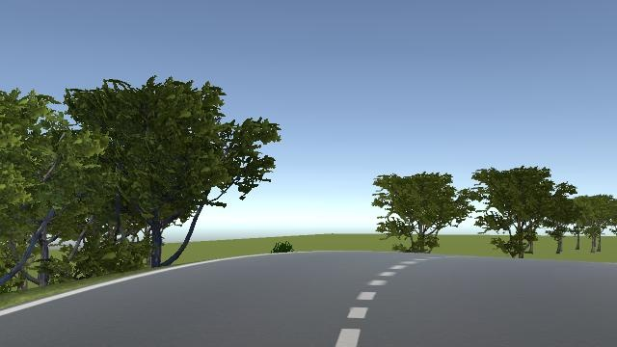

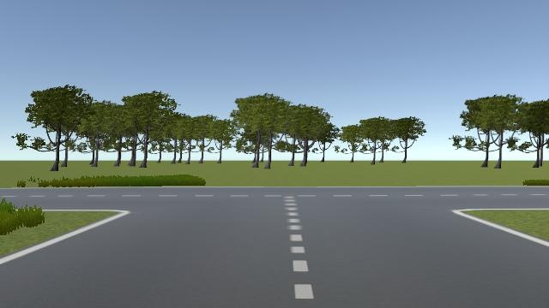


Challenges
Max $≡$ min
No max, min
Line 31 => line 45
Angle = angle +(-) 1
Timer
Timer
Straight
Turn 25

